Slide 1
MyFlightbook Admin/Support

Slide 2
Overview
All accounts have one or more of the following roles
Role | Lets you…
None (Pilot) | Use the site Everyone has this
Support | Reset passwords, impersonate users, receive “Contact Us” email
Data Manager | Edit aircraft/models/airports/FAQs/Achievements/Endorsements
Reporter | View site stats, receive nightly report
Accountant | View and manage donations
SiteAdmin | All of the above plus receive errors, crash reports, etc.

Slide 3
Key Scenarios

Slide 4
Key Support Scenarios
Questions in FAQ (that’s why there’s a FAQ) – can review FAQ to see these
Forgotten passwords/Locked accounts
Feature requests or questions
Typically get 2-5 such support requests/day.

Slide 5
Key Management/Admin Scenarios
Data management and integrity
Dealing with new make/models.
Aircraft edits
Verifying site health
Crashes

Slide 6
Email

Slide 7
Emails that get sent automatically
New User – can ignore/delete, but is good indicator of health of site
I have a rule to move to a separate folder
New Manufacturer
Need to check for/resolve dupes, generic (e.g., “Various”, etc.); I try to have only one made-up manufacturer for this (“Generic”).
Need to restrict certain manufactures to be only sims or anonymous. E.g., Frasca is only a SIM, “Generic” can be a sim or an anonymous aircraft (“Anonymous ASEL”, for example), but not a real aircraft
New model or model updates
Need to verify dupes, possibly merge
Common errors:
Assigning a type-ID to a non-type-rated aircraft (e.g., C-172)
Incorrect or missing ICAO identifier (I use https://www.icao.int/publications/DOC8643/Pages/Search.aspx to look up)
Duplicates of other models
Consistency in naming (e.g., Cessnas tend to use a hyphen, like C-172, but Pipers don’t, like PA28)
Edit to or clone of an aircraft that is shared among users
Nightly Stats
Locked Account
Accounts get locked after too many unsuccessful sign-in attempts or failed password reset attempts
Admin page shows locked user, enables unlock (I usually just unlock after waiting a few minutes)
Crashes (from both website and mobile devices)
Some can be ignored (“Invalid Postback” is the most common, I should see all others.)

Slide 8
Customer-initiated emails
Subject generally identifies source (Website, iPad, Android, etc.)
Most questions are addressed in the FAQ.
I tend to answer them anyhow…
Reset Password
Admin page has a Password Reset function
Sometimes users don’t receive the email.
Requests for features or flight properties.

Slide 9
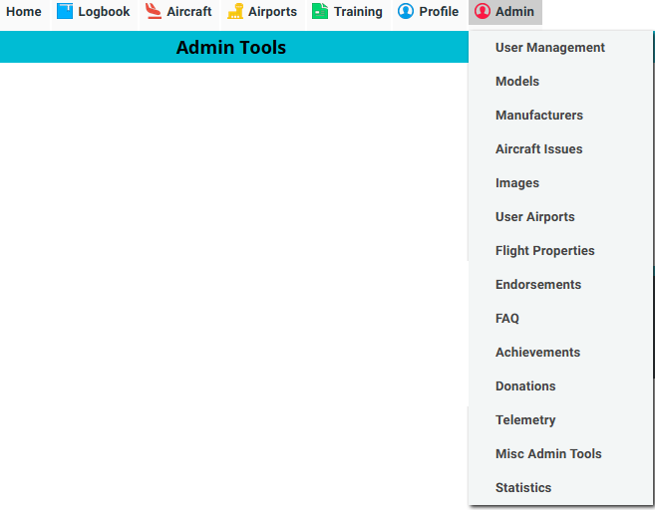
Admin Tools
Admin tab is available only to people signed in using an admin-enabled account

Slide 10
Customer Support Tools

Slide 11

Admin Tools: User management
Type the name or email of a user, then click “Find”
This is the account’s username; it is unique and invariant, even if email address changes

Slide 12
Admin Tools: User Management
Impersonate – use for troubleshooting
Lets you act as if you were that user
Click in header to stop impersonating
On mobile apps: emulate by prepending their username to your email with a colon and using your password.
E.g., “userabc:support@gmail.com” allows support@gmail.com account to emulate userabc, if support@gmail.com is authorized to emulate.
Reset Password
You have to manually send it to them, but a button will do this with one click.
Delete User: Delete’s entire account!!
Delete Flights for user: generally for when somebody tried an import and messed up and wants to start over.
Send Message: let’s you compose an email to the user (useful to see if they can receive it)
Endow Club Creation – largely obsolete; allows them to create a club without donating

Slide 13
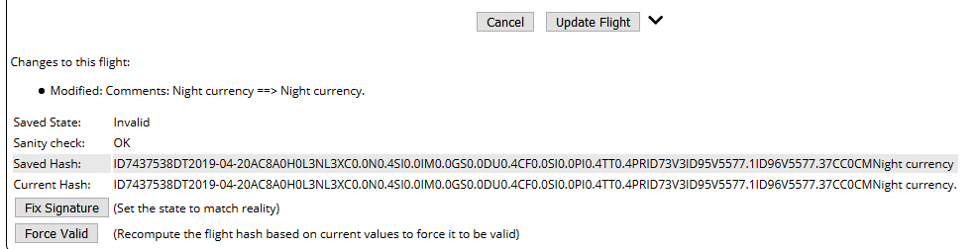
Admin Tools: Viewing Flight
a=1 in URL lets you view a specific flight
Mostly for troubleshooting, but can also fix signatures.

Slide 14
Data Management

Slide 15
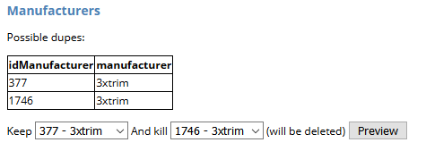
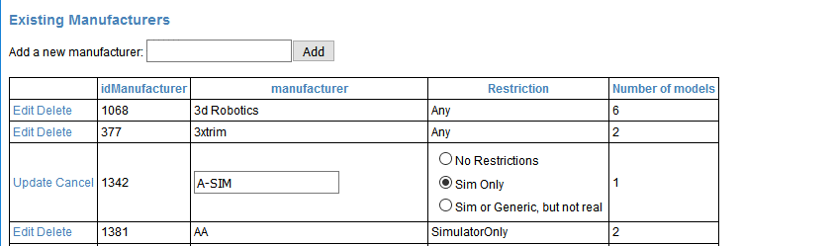
Admin Tools: Manufacturers
Can identify/merge duplicate manufacturers (much like models)
Can sort by clicking header
Delete ones with 0 models
Click “Edit” to modify
Generally only want to edit manufacturer restrictions, but may want to edit the name as well.

Slide 16
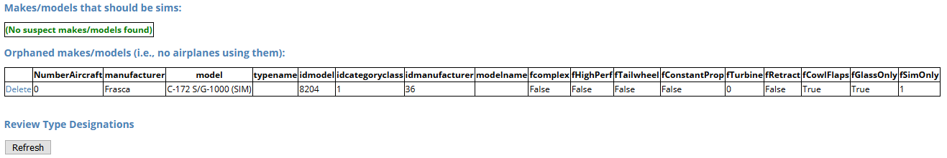
Admin Tools: Models
Review data integrity
Displays models that have no sim/generic restriction, but whose models specifies that they should.
Can arise if restriction applied to manufacturer after model is created
Review/delete orphaned models (see next slide)
Review models with type designations to ensure that they are consistent and appropriate.
E.g., C-172 shouldn’t have a type rating, all Boeing 777’s should have a type rating of “B777”, not a mixture of “B-777” and “B777”, etc.
Click “Refresh” to view them
Type ratings follow conventions at http://registry.faa.gov/TypeRatings/

Slide 17
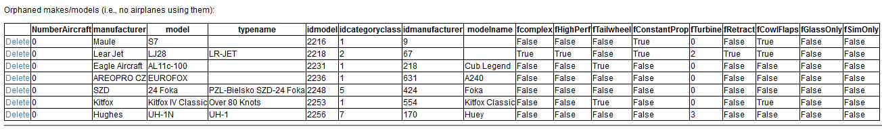
Admin Tools: Orphaned Models
Good to periodically clean these up
Let them sit for at least a few days
Deleting a model may leave an orphaned manufacturer to clean up.

Slide 18
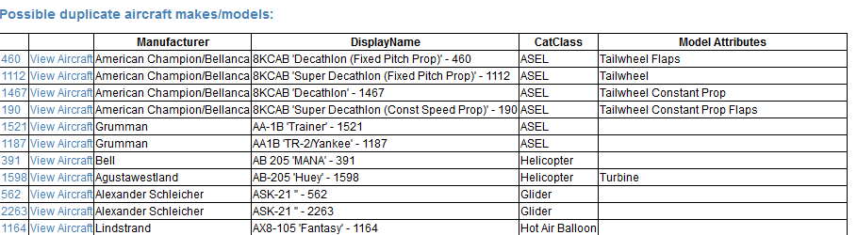
Admin Tools: Models
Identifies models that appear to be dupes of one another.
Can click model ID to view details, or view aircraft

Slide 19
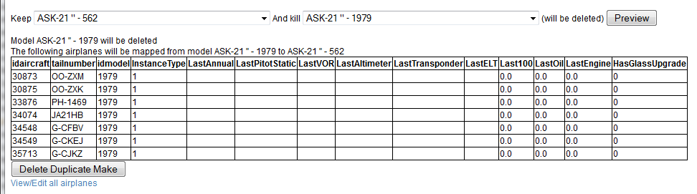
Admin Tools: Duplicate Models
Drop-downs let you decide which to keep and which to kill.
Click Preview to see which aircraft will be mapped, then Delete Duplicate Make to consolidate.
I generally preserve the one that modifies the fewest aircraft, or the oldest one (lowest modelID)

Slide 20
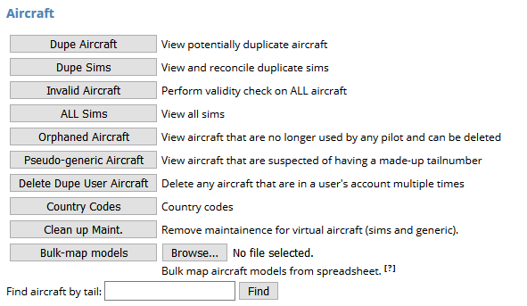
Admin Tools: Aircraft
Dupes: show aircraft that could be duplicates of each other
Dupe Sims: when models are merged, could be dupes.
In a set of duplicates, can click “Keep this” to resolve the duplicate for the same model/sim level
Invalid Aircraft: does an integrity check on all aircraft
All Sims: displays all sims in the system, allows for renaming. Just informational, really.
Orphaned Aircraft: displays all aircraft that have no owners
E.g., pilot created it, then removed it from their profile.
Good to clean these up periodically; doing so can reveal models that are also orphaned, and possibly cleaning that up would reveal an orphaned manufacturer.
Pseudo-generic aircraft: shows aircraft that look like proxies for generic aircraft.
E.g., creating a C-172 with the tailnumber “C172”, or “NGENERIC”, or things like that.
When you click “View” next to one of these aircraft, it will show you a “Migrate to Generic” button on the edit aircraft page; this will move the user to an anonymous aircraft and away from this one.
Delete Dupe User Aircraft: looks for users with multiple copies of the same aircraft in their profile and resolves the dupes
Country Codes: Allows for management of aircraft prefixes
Whether or not a hyphen should be used by default
Template for looking up of aircraft registrations
Clean Up Maintenance: you can’t maintain a sim or generic, so this removes any such records
Shouldn’t happen
Bulk Map Models: allows bulk mapping of aircraft from one model to another.
Find Aircraft by Tail: allows lookup of aircraft by registration (no partial search)

Slide 21
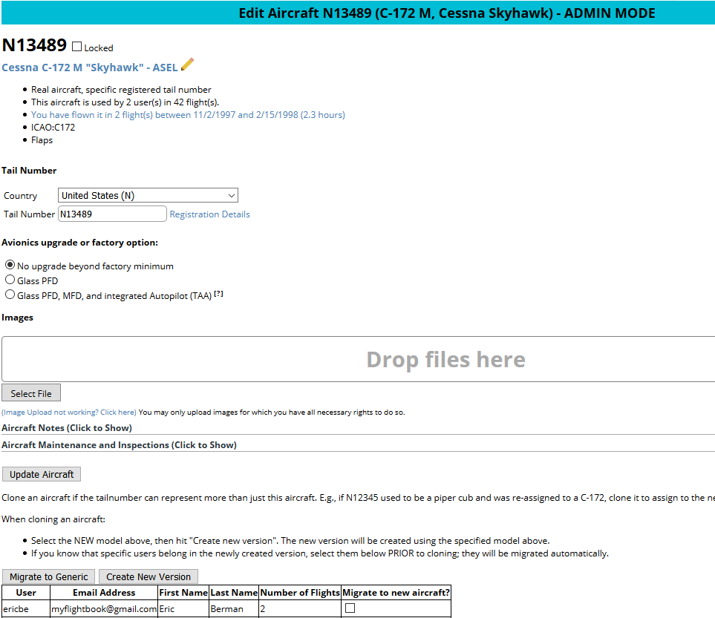
Admin Tools: Edit Aircraft
Prevents non-admins from editing this (if too many back-and-forth edits, a-la wikipedia)
a=1 in URL gives admin mode
Enables creation of a new version of the aircraft. (Follow instructions on page). This is how you deal with things like a registration being re-assigned, or an aircraft that is part-time on floats and part time on wheels.
gencandidate=1 in URL gives migration

Slide 22
Rules about editing aircraft
If… | Then… | Email sent?
Aircraft is locked, sim, or generic | NO EDIT is permitted. (Admin can edit locked aircraft) | N/A
User is ONLY pilot with that aircraft | Underlying aircraft is edited. | No
ICAO code OR category/class changes (E.g., B-737 to C-172) | “Major change” – aircraft is cloned, user put into clone | All pilots in that aircraft + admin is notified to review. Admin has a “Make Default” button to choose preferred version
All other edits (e.g., C-172N to C-172S) | “Minor change” – underlying aircraft is edited | All pilots in that aircraft + admin is notified to review

Slide 23
Images/videos on MyFlightbook
MyFlightbook Server
Upload image/video/PDF
File System
DB
Serve thumbnails
Client (Web or mobile app)
Upload full images to S3
Amazon S3
Serve full image/video/PDF

Slide 24
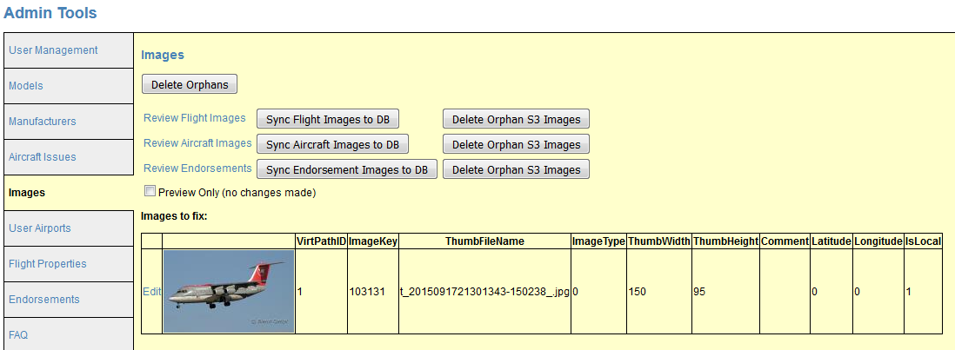
Admin Tools: Images
Delete Orphans: resolves inconsistencies when images are around after a flight/aircraft has been deleted
Don’t need to use often
Review (x) images: allows you review images, migrate any local images
Sync Flight Images to DB – SLOW but resolves discrepancies between database and thumbnails/images on disk
Delete Orphan S3 Images: also rarely needed, but looks for images on Amazon S3 that aren’t in the database and deletes them
Images to fix: two issues sometimes arise; can be fixed here:
Images that have “IsLocal” set (i.e., migration to S3 failed). Can migrate it from the “Review xxx Images” page.
Thumbnails sometimes don’t get width/height attribute correctly set

Slide 25
Admin Tool: Review Images
Can review flight images, aircraft images, and endorsements
Two goals:
Ensure compliance with appropriate usage (no obviously copyrighted material, no porn, etc.)
Delete duplicates, which sometimes arise
These pages can be slow.
There is a “Migrate” option at the top of the page to migrate images to S3. Only use this if the main images page reports that there are local images

Slide 26
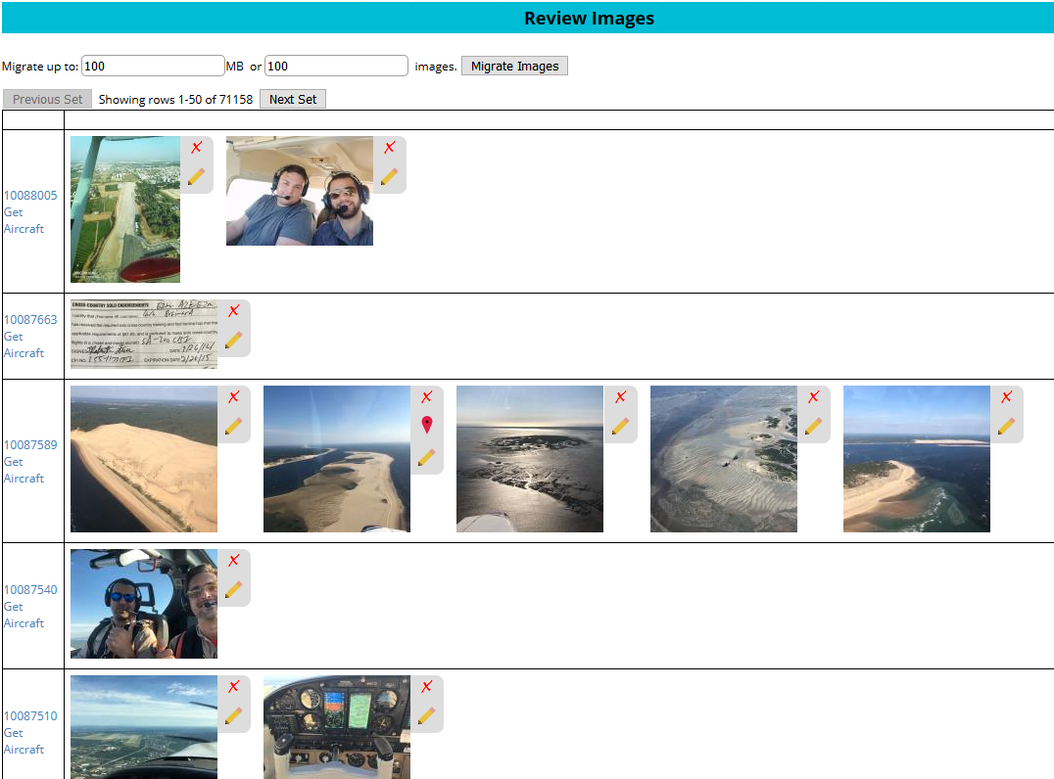
Review Images Example
Page through images
Migrate local images to Amazon S3, subject to limitations on the left
Click the “x” to delete (can’t be undone!!)
Link to underlying object (flight, etc.)
Click “Edit” to change a caption
For flights, you can get a link to the flight’s aircraft in case the image properly belongs there.

Slide 27
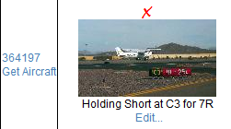
Review Images: flights
Sometimes people put images of the aircraft in their flight, and put that image on multiple flights.
When reviewing flights, there is a “Get Aircraft” link that provides a link to the aircraft for the flight
If it’s a good picture and shows the tailnumber, I will generally move the image to the aircraft and then delete from the flight
Or, if the image is already on the aircraft, simply delete it from the flight.

Slide 28
Admin Tool: User Airports
A | Airport
C | VORTAC
D | VOR/DME
F | FAN Marker
FX | Airspace Fix
H | Heliport
L | LFR
LC | Localizer or SDF
LM | LMM
LO | LOM
M | Marine NDB
MD | Marine NDB/DME
ML | MLS or ISMLS
R | NDB
RD | NDB/DME
S | Seaport
T | TACAN
U | UHF NDB
V | VOR
Can review all user-created airports
There is also a bulk-upload tool for airports.
Bulk upload is a CSV file with columns:
FAA: FAA Designator for the airport/navaid (e.g., “SFO”)
ICAO: ICAO Designator for an airport/navaid (e.g., “PHOG”)
IATA:IATA Designator for an airport/navaid (e.g., “OGG”)
Name: Name of the airport/navaid
(Latitude, Longitude) OR (LatLong): location of the airport/navaid
Type: code (see table at right) for type of facility
When doing bulk import, can review each airport and decide whether to import, or to update existing item in database.

Slide 29
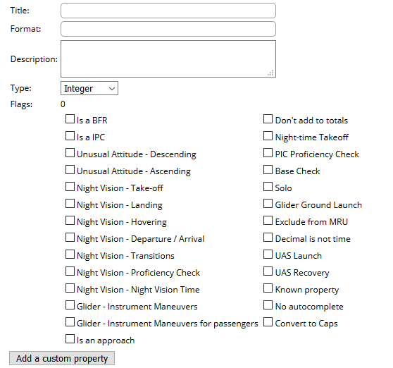
Admin Tools: Edit Properties
Title: Identifies the property (e.g., “Approaches – ILS”)
Format String: displays the property’s value (e.g., “3 ILS Approaches”). “{0}” is the placeholder for the value.
Description:Explains the purpose/usage of the property
Type: what kind of property is this (count of events, true/false, text, etc.)
Flags: indicate special semantics of the property (mostly for use in things like currency computations). Set flags using checkboxes.

Slide 30
Property Guidelines
Keep properties as general purpose as possible.
E.g., “Charity Flight” rather than “Angel Flight”
Add properties only for things that really don’t belong in comments – i.e., for which a pilot might wat to do a structured search or a pivot table in Excel
Avoid properties that combine independent things
E.g., stay away from “Night Cross-country” or “Solo Night Cross Country.”.
This is an invitation to ambiguity or errors in the data, don’t do it.

Slide 31
Admin Tools: Endorsement Templates
This is where templates can be created/edited for endorsements that a flight instructor can give to a student
Uses a pseudo-markup language to specify placeholders for student name, date, etc.
{x} for a single-line entry with watermark "x"
{Freeform} for freeform multi-line text (no watermark prompt)
{Date} for the date (prefilled)
{Student} for the Student's name (pre-filled)
{x/y/z} for a drop-down of choices x, y, and z

Slide 32
Admin Tool: Edit FAQ
Link to FAQ is on bottom of every page.
FAQ items consist of a category, a question, and an answer. They are grouped by category at display time.
FAQ answer can contain HTML markup
FAQ is branding-aware (will use correct brand based on environment)
All links should use relative paths (i.e., not include the domain name) to work with multiple brands
%APP_NAME%: the name of the app
%SHORT_DATE%: Current date format (short) - date pattern
%DATE_TIME%: Current time format (long) - sample in long format
%APP_URL%: the URL (host) for the current request.
%APP_ROOT%: The root (analogous to "~") for the app brand.
%APP_LOGO%: the URL for the app logo
E.g., the “Contact” link is http://%APP_URL%%APP_ROOT%/Public/ContactMe.aspx which translates to http://myflightbook.com/logbook/Public/ContactMe.aspx

Slide 33
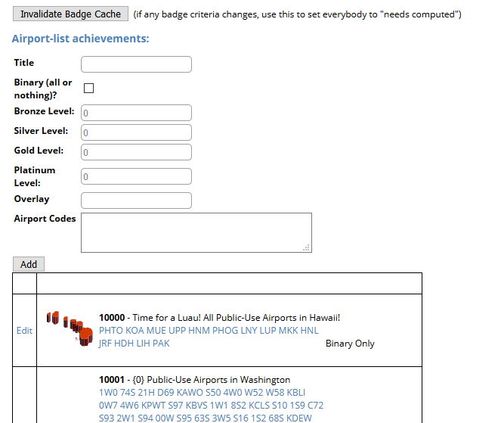
Admin Tool: Achievements
Two functions:
Invalidate cache of user achievements (i.e., force it to be computed next time they view achievements
Create new airport achievements
Airport achievements:
Title: self explanatory
Binary: if checked, this is something you achieve or you don’t achieve (and subsequent items are ignored)
Bronze/silver/gold/platinum: how many airports in the list do you need to land at to achieve these levels? (Need to be ascending)
Overlay: name of the PNG file in the Images directory that overlays the badge
Airport codes: the set of airports that comprise the achievement

Slide 34
Admin Tools: Telemetry
Allows migration of telemetry between database and individual disk files (similar to images and Amazon S3)
Can also reconcile data inconsistencies, look up telemetry on a per-user basis, and see stats.
Fun “Antipodes” tool

Slide 35
Admin Tools: Misc
Handle duplicate/empty properties
Just click them to view them in context and delete them (obviously only one in the case of duplicates).
I think I’ve finally caught all the scenarios where this can happen; haven’t seen dupes in a while
Investigate/recompute invalid signatures (slow!)
Can arise if aircraft changes (e.g., clone or merging of duplicate aircraft)
Best to do this on a development machine first.
Flush the cache on the live site (to pick up DB changes)

Slide 36
Reporting

Slide 37
Donations
View details of donations made by time period
Search for donations by username
Add transactions manually to make adjustments
Does NOT issue refunds!! This is just local recordkeeping

Slide 38
Admin Tools: Stats
Displays some interesting usage statistics for the site.
No actions necessary in this section
Emailed nightly
SLOW to compute

Slide 39
Misc

Slide 40
Shunting the site
LAST RESORT – CALL ME
Site can be shunted if necessary
Requires editing Web.config on live site. Search for word “Shunt” and you’ll see what to do. Save the change. Undo it to un-shunt

Slide 41
Misc: Autoreply
Can set up an “Out of office” that will auto-respond to Contact Us page
“UseOOF” to “yes” in Appsettings.config to turn on
Replies using localized text from emailtemplates.

Slide 42
My Contact Information
Eric Berman
myflightbook@gmail.com
Ericbe_expe@hotmail.com
ericbe@hothpark.com
425-483-8327 (h)
425-765-9873 (c)

Slide 43
Questions?

